Slide 1


Artificial Intelligence: The Future is Now
Artificial intelligence (AI) has become an increasingly prevalent force in our lives, transforming industries and shaping the future.
by Hammad Zahid

Slide 2
What is Artificial Intelligence?
Definition
Types
AI refers to the simulation of human intelligence processes by computer systems. These processes include learning, problem-solving, and decision-making.
There are various types of AI, including narrow AI (performing specific tasks), general AI (human-level intelligence), and super AI (surpassing human intelligence).

Slide 3
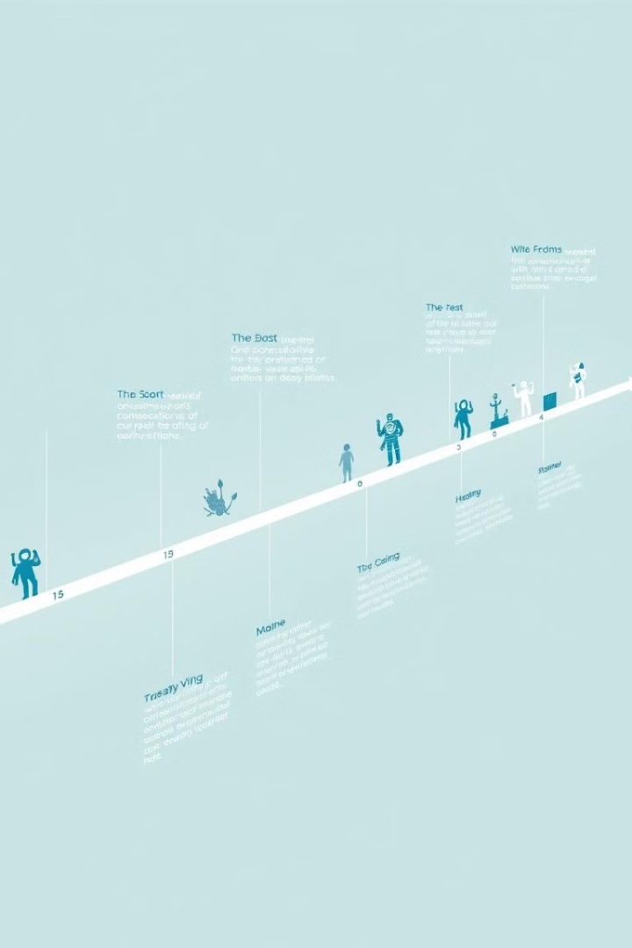
The History and Evolution of AI
1
Early concepts emerged in the 1950s, laying the foundation for AI research.
2
The 1980s saw the rise of expert systems and the development of machine learning techniques.
3
Recent advances in computing power and data availability have led to rapid progress in deep learning and other AI subfields.

Slide 4

Key Applications of AI
Healthcare
Finance
AI is revolutionizing healthcare with personalized medicine, disease diagnosis, and drug discovery.
AI-powered algorithms are used in fraud detection, risk assessment, and automated trading.
Transportation
Manufacturing
AI is driving the development of self-driving cars, traffic optimization, and logistics management.
AI is automating production processes, improving efficiency, and enhancing product quality.

Slide 5



Machine Learning and Deep Learning
Machine Learning
Deep Learning
Machine learning allows computers to learn from data without explicit programming. It includes supervised, unsupervised, and reinforcement learning.
Deep learning is a subset of machine learning that uses artificial neural networks with multiple layers to analyze complex data.

Slide 6





Challenges and Limitations of AI
Data Bias: AI systems can inherit biases from the data they are trained on.
Explainability: Understanding the decision-making process of complex AI models can be challenging.
Job displacement: AI automation may lead to job losses in certain sectors.
Security risks: AI systems can be vulnerable to attacks and manipulation.

Slide 7




The Ethical Considerations of AI
Privacy
1
Data collection and use in AI systems raise concerns about privacy and personal information.
Fairness
2
AI algorithms should be designed to be fair and equitable, avoiding discriminatory outcomes.
Transparency
3
AI systems should be transparent and accountable, allowing for understanding of their decision-making processes.
Safety
4
AI systems should be safe and reliable, minimizing risks to humans and the environment.

Slide 8

The Future of AI: Trends and Predictions
10B
100%
Data Explosion
AI Integration
The rapid growth of data will fuel further advancements in AI.
AI will become increasingly integrated into all aspects of our lives.
$100B
100M
Market Growth
Jobs
The global AI market is expected to reach hundreds of billions of dollars.
AI will create millions of new jobs, while also transforming existing ones.

